Slide 1
Antenatal care and ultrasound in obstetrics
Prof. Tiran Dias

Slide 2
Objectives of Antenatal Care
To prevent, detect and manage factors which affect adversely to the wellbeing of the mother and baby
To provide advice, reassurance, education and support for the mother and family
To deal with the ‘minor ailments’ of pregnancy
To provide general health screening of the mother

Slide 3
Antenatal care
Shared care
Community based care
Hospital based care

Slide 4
The booking visit
Confirmation of the pregnancy
Assessing the gestational age/dating
Complete history and examination
Other investigations
Screening for anaemia, clinical conditions, fetal abnormalities etc.

Slide 5
The booking visit cont’d…
Confirmation of the pregnancy:
Urinary or serum β-hCG levels
Dating Ultrasound scan

Slide 6
The booking visit cont’d…
Assessing the gestational age/dating
Dating and assessing the expected date of delivery(EDD) by the LMP
- Naegele’s method: add 9 months and 7 days to the first day of LMP

Slide 7
The booking visit cont’d…
2. Assessing the gestational age by ultrasound scan
Crown-rump length (CRL), head circumference (HC) used to calculate the gestational age.
If the EDD predicted by the scan differs more than 4 days from the menstrual EDD the scan date is taken as correct.
After 20 weeks of gestation, the accuracy becomes progressively less.

Slide 8
The booking visit cont’d…
Complete history and examination
History to identify risk factors for gestational diabetes mellitus, pre eclampsia
Measure height, weight and body mass index
Blood pressure measurement

Slide 9
The booking visit cont’d…
1st Booking visit investigations
Full blood count (Hemoglobin level)
Blood group
VDRL/ HIV 1 & 2
Glucose tolerance test
Urine Full Report

Slide 10
The booking visit cont’d…
Screening for anaemia
Screening should take place early in pregnancy at booking visit and at 28 weeks
Full blood count is the recommended testing
This allows enough time for treatment if anaemia is detected
iron supplementation is considered if indicated

Slide 11
The booking visit cont’d…
blood grouping
Women should be offered testing for blood group and rhesus D status in early pregnancy

Slide 12
The booking visit cont’d…
Screening for gestational diabetes
At booking visit, assess risk with history taking and examination
BMI above 30kg/m²
Previous macrosomia baby weighing 4.5 kg or above
Previous gestational diabetes
Family history with diabetes
Testing
- Oral glucose tolerance test (OGTT) at booking and at 24- 28
weeks if first OGTT results are normal

Slide 13
The booking visit cont’d…
Screening for pre eclampsia
At booking visit, risk factors should be determined with history
Age 40 years or older
Nulliparity
Previous history of pre eclampsia
Body mass index 30kg/m² or above
Family history of pre eclampsia
Blood pressure measurement
Urinalysis for protein
should be carried out at booking visit and each antenatal
visit

Slide 14
Screening for asymptomatic bacteriuria
Mid stream urine culture is the recommended method for diagnosing asymptomatic bacteriuria in early pregnancy
Identification and treatment reduces the risk of pyelonephritis

Slide 15
Nutritional supplements
Daily oral iron and folic acid supplementation with 30 mg to 60 mg of elemental iron and 400 µg (0.4 mg) of folic acid is recommended for pregnant women to prevent maternal anaemia, puerperal sepsis, low birth weight, and preterm birth.
In populations with low dietary calcium intake, daily calcium supplementation (1.5–2.0 g oral elemental calcium) is recommended for pregnant women to reduce the risk of pre-eclampsia.

Slide 16
Ultrasound in Obstetrics

Slide 17
Ultrasound in Obstetrics
Ultrasound in first trimester
The early pregnancy scan (11-14 weeks)
- Usually performed as a trans-abdominal scan
- Principle aims are,
To assess the number of fetuses and confirm the fetal viability
To determine chorionicity if it is a multiple pregnancy
To estimate the gestational age
To identify markers of chromosomal abnormalities. Eg. Nuchal translucency in Down’s syndrome
To identify fetal gross structural abnormalities

Slide 18
To assess the number of fetuses and confirm the fetal viability
- Number of gestational sacs
- Number of visible heartbeats

Slide 19
To determine chorionicity
- Best done at 11-14 weeks
- λ sign : dichorionic
- T sign : monochorionic
- Number of placental masses

Slide 20
Estimation of gestational age
Crown-Rump Length (CRL) -
Head circumference(HC)
In practice CRL and HC are often used because they are the most reproducible measurements.
Essentially, earlier the measurement is made better the accuracy.
Before12 weeks of gestation (first trimester)
During 14-25 weeks of gestation
(second trimester)

Slide 21
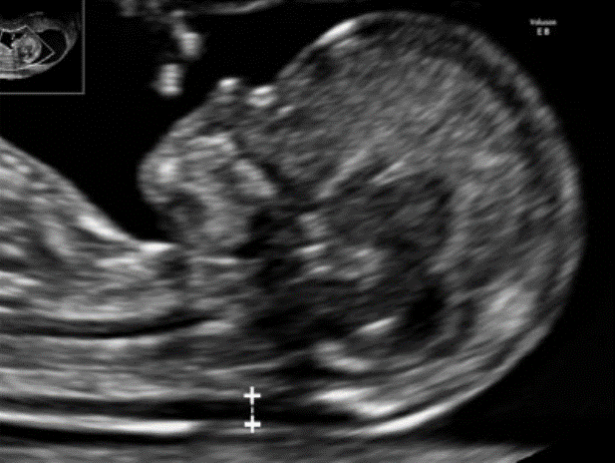
Screening for common chromosomal abnormalities
Screening for trisomy 13, 18 & 21 can be performed in the first trimester using the combined test (nuchal translucency thickness (NT), free beta-human chorionic gonadotropin (β-hCG) level and pregnancy-associated plasma protein-A (PAPP-A) level).

Slide 22
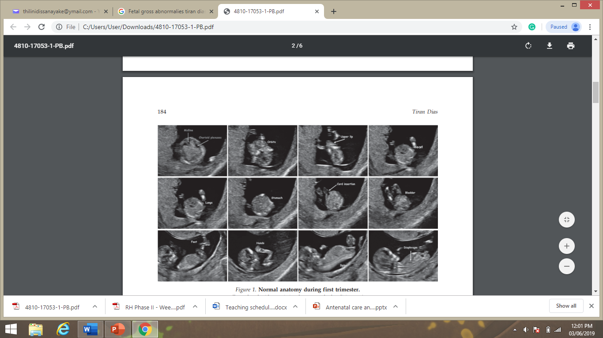
Screening for fetal gross structural abnormalities

Slide 23
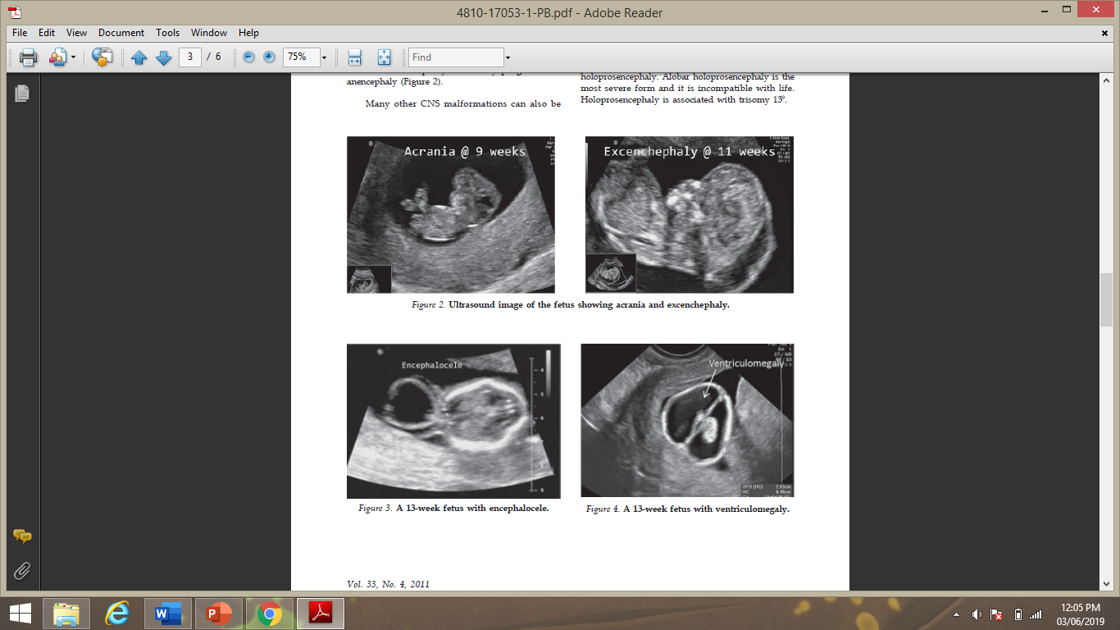

Slide 24
Ultrasound in second trimester(18-22 weeks)
Fetal anatomy to detect any fetal structural abnormalities or markers for chromosomal abnormalities
Placental location to detect low lying placenta which has a risk of developing into placenta praevia,
Amniotic fluid volume, And calculation of Amniotic Fluid Index(AFI) to assess fetal growth retardation and or any oher cause.

Slide 25
Ultrasound in second trimester cont’d
4. Doppler ultrasound examination of maternal uterine arteries to screen for adverse pregnancy outcome
5. Measurement of cervical length to assess the risk of preterm delivery
Umbilical cord

Slide 26
Ultrasound in third trimester
-to assess fetal growth and wellbeing
Measurements used to assess fetal growth are,
Biparietal Diameter
Head Circumference
Abdominal Circumference
Femur Length
Estimated Fetal Weight
All measurements can be immediately compared with a normal reference range.
In pregnancies at high risk of IUGR, serial measurements are plotted on normal reference charts.

Slide 27
Biophysical profile
Biophysical variables used are,
Fetal breathing movements
Gross body movements
Fetal tone
Reactive fetal heart rate
Qualitative amniotic fluid

Slide 28
Doppler investigation
Waveforms are obtained from both the umbilical and fetal vessels
Umbilical artery
Information regarding placental health and function is obtained.
Where there is a constant diastolic flow in normal and in abnormal a absent or reversed diastolic flow and has a strong correlation with fetal distress and IUD
A measure of the amount of diastolic flow relative to systolic flow is provided by several indices such as pulsatility index or resistant index.
When these indices are high it indicates high resistant flow

Slide 29
Fetal vessels
Middle cerebral artery Doppler
An indicator of fetal anemia.
In anaemia the peak systolic velocity increases.
Useful in assessing severity of Rhesus disease and twin-to-twin transfusion syndrome which results in anaemia in the donor twin

Slide 30
Thank you!

